Slide 1
Implementation of ICH Q8-Q9-Q10
(2024 Update of Training Materials)
International Council for Harmonisation of Technical Requirements
for Pharmaceuticals for Human Use

Slide 2
Legal Notice
This presentation is protected by copyright and may, with the exception of the ICH logo, be used, reproduced, incorporated into other works, adapted, modified, translated or distributed under a public license provided that ICH's copyright in the presentation is acknowledged at all times. In case of any adaption, modification or translation of the presentation, reasonable steps must be taken to clearly label, demarcate or otherwise identify that changes were made to or based on the original presentation. Any impression that the adaption, modification or translation of the original presentation is endorsed or sponsored by the ICH must be avoided.
The presentation is provided "as is" without warranty of any kind. In no event shall the ICH or the authors of the original presentation be liable for any claim, damages or other liability arising from the use of the presentation.
The above-mentioned permissions do not apply to content supplied by third parties. Therefore, for documents where the copyright vests in a third party, permission for reproduction must be obtained from this copyright holder.​

Slide 3
Note about this training material
This training presentation on ICH Q8/Q9/Q10 is based in part on unofficial presentations and workshop materials developed in 2010 by several members of the ICH Q8/9/10 Implementation Working Group (IWG).
Parts of those materials have been merged and incorporated into this presentation, and given the 2023 revision of ICH Q9, some aspects of those old 2010 presentations) were updated in this presentation to better integrate Quality Risk Management approaches in alignment with the revised guideline, ICH Q9(R1).
In addition, it is important to note that a substantial part of those 2010 materials was focused on product and process development, and thus, a substantial part of this presentation is also related to product and process development.

Slide 4
Agenda
Key concepts of how ICH Q8, Q9 and Q10 integrate together
The Pharmaceutical Quality System (PQS) Framework of ICH Q8, Q9, and Q10
Context and benefit of the 3 guidelines
PQS framework - Lifecycle approach, QRM and KM
PQS at Development Stage (Q8)
Process using QRM and establishing initial control strategy
Process design and initial design space
PQS at Commercial Manufacturing Stage (Q10)
Manufacturing and Inspection
Lifecycle QRM and Continual Improvement

Slide 5
The Pharmaceutical Quality System (PQS) Framework of ICH Q8-Q9-Q10
International Council for Harmonisation of Technical Requirements
for Pharmaceuticals for Human Use

Slide 6
The Q8-Q9-Q10 Framework The context and benefit of the 3 guidelines
This training material is designed to help understand why ICH Q8, Q9, and Q10 were written as a trio and form the lifecycle foundation for medicinal quality.​
Why were these three guidelines written as a trio?
Regulators and industry agreed there was a need for a harmonized, integrated pharmaceutical quality system framework that is applicable throughout the product lifecycle.
How do the guidelines create a lifecycle foundation?
The trio of guidelines establish a lifecycle Quality System framework that facilitates appropriate risk-based decisions starting at drug development stage and throughout the entire drug lifecycle.
When effective, a quality system will ensure sound development that supports successful technology transfer, and thereafter adapts and improves the operation throughout the commercial lifecycle to ensure a continuing state of control in accord with GMPs.

Slide 7
The Q8-Q9-Q10 Framework
ICH Q8 Pharmaceutical Development: Overview
The guidance describes the suggested contents for the pharmaceutical development section of a regulatory submission in the ICH M4 Common Technical Document (CTD) format.
The information and knowledge gained from pharmaceutical development studies provide scientific understanding to support the establishment of specifications and manufacturing controls.
The guidance also indicates areas where the provision of greater understanding of pharmaceutical and manufacturing sciences can create a basis for flexible regulatory approaches.

Slide 8
The Q8-Q9-Q10 Framework
ICH Q9(R1) Quality Risk Management: Overview
The guideline is intended to provide guidance on quality risk management principles and tools that can be applied to different aspects of pharmaceutical quality:
“An effective quality risk management approach can further ensure the quality of the drug (medicinal) product to the patient by providing a proactive means to identify and control potential quality issues during development, manufacturing and distribution.”
“A proactive approach to quality risk management is beneficial, as it facilitates robust product design and continual improvement, and it is of strategic importance in achieving an effective pharmaceutical quality system. (See ICH Q10 for guidance in relation to an effective pharmaceutical quality system.) Additionally, use of quality risk management can improve the decision-making if a quality problem arises.”
“This includes an appropriate application of root cause analysis that can identify and address the root cause(s) and other causal factors (e.g., human-related) of such issues.”

Slide 9
The Q8-Q9-Q10 Framework
ICH Q10 Pharmaceutical Quality System: Overview
ICH Q10 is a comprehensive model for an effective pharmaceutical quality system that is based on applicable good manufacturing practice (GMP) regulations and basic International Organization for Standardization (ISO) quality concepts.
ICH Q10 can be implemented throughout the different stages of a product lifecycle
Pharmaceutical Development
Technology Transfer
Commercial Manufacturing
Product Discontinuation
Implementation of ICH Q10 throughout the product lifecycle should facilitate innovation and continual improvement, and strengthen the link between pharmaceutical development and manufacturing activities.
Pharmaceutical Development
Technology
Transfer
Commercial
Manufacturing
Discontinuation

Slide 10
The Q8-Q9-Q10 Framework The context and benefit of the 3 guidelines
Numerous benefits for the internationally harmonized paradigm, including:
Common framework for lifecycle quality management
Better systems for managing risks to quality and enhanced patient-centric decision-making
Senior management oversight
Increased confidence between industry and regulators
A lifecycle approach
Improved development. More focus on investing in better development approaches to:
Increase Process Understanding
Provide a stronger foundation to establish successful technology transfer and support initial state of control
Systems to maintain long-term state of control, including process performance and product quality monitoring (e.g., process capability)
Continual improvement and improved change management
Facilitate innovation and new technology (e.g., appropriate implementation of PAT, RMM)
Increased flexibility to implement quality improvements

Slide 11
The Q8-Q9-Q10 Framework The context and benefit of the 3 guidelines
Q8R2, Q9R1 and Q10 were designed as an integrated system, with each guideline providing specifics on needed elements that function together to support product realization and lifecycle state of control.
ICH Q8: Effective pharmaceutical development uses sound science and data to support the realization of a new product that is a safe and effective based on a well-designed and controlled manufacturing process.
ICH Q10: The PQS provides structures and processes that ensure good development and vigilant oversight of the commercial manufacturing to maintain it in a continued state of control.
ICH Q9 (R1): QRM is used throughout the entire lifecycle as an enabler to:
facilitate risk-based decisions and implement a sound QRM program that ensures the level of effort, formality and documentation are commensurate with the level of risk.
ensure medicinal quality for patients by providing a proactive means to identify and control potential quality issues during development, manufacturing, and distribution.
Q8 Pharmaceutical development
Q9 (R1) Quality Risk Management
Q10 Pharmaceutical Quality System

Slide 12
The Q8-Q9-Q10 Framework The context and benefit of the 3 guidelines
Q10 implementation should result in achieving several objectives, including:
Achieve Product Realization
Establish and Maintain a State of Control
Facilitate Continual Improvement over the product lifecycle
Enablers: Use of knowledge management and QRM will enable a company to implement Q10 effectively and successfully.

Slide 13
The Enablers:
The Foundation of the Pharmaceutical Quality System
Systematic approach to acquiring, analysing, storing, and disseminating information related to products, manufacturing processes and components.
A systematic process for the assessment, control, communication and review of risks to the quality of the drug (medicinal) product across the product lifecycle.
Knowledge Management (KM)
Quality Risk Management (QRM)

Slide 14
Linkage between QRM and Knowledge Management
It is essential that adequate resources and knowledge are available to support the QRM process. Incomplete knowledge can impact QRM effectiveness.
For example, when performing the risk assessment aspect of QRM, key knowledge inputs would include:
Identifying needed data and information (to support hazard identification);
Analysing raw data and other relevant information sources (risk analysis);
Determining the degree of residual uncertainty and where knowledge gaps remain
Evaluating available data, results from measurements, and other knowledge to determine significance of risks (risk evaluation)
These decisions on risks, and the associated risk controls (risk acceptance), should be captured and documented for use throughout the lifecycle
New knowledge should be monitored, and acceptability of risk controls revisited whenever appropriate (risk review)
Knowledge management also facilitates communication about risks among stakeholders (risk communication)

Slide 15
Knowledge Management Requires Systematic Approach to Assuring Process Performance & Product Quality
ICH Q8(R2) states that better process development approach can provide a strong foundation for lifecycle quality improvement. It states that a "more systematic approach could facilitate continual improvement and innovation throughout the product lifecycle (See ICH Q10)."
ICH Q10 provides further details on the systematic approach:
It notes that a manufacturer should "develop and use effective monitoring and control systems for process performance and product quality to provide assurance of continued suitability and capability of processes."
The guideline adds that "A well-defined system for process performance and product quality monitoring should be applied to assure performance within a state of control and to identify improvement areas."
Ultimately, this data and other quality system information provides the knowledge to "implement appropriate product quality improvements, process improvements, variability reduction, innovations and pharmaceutical quality system enhancements."

Slide 16
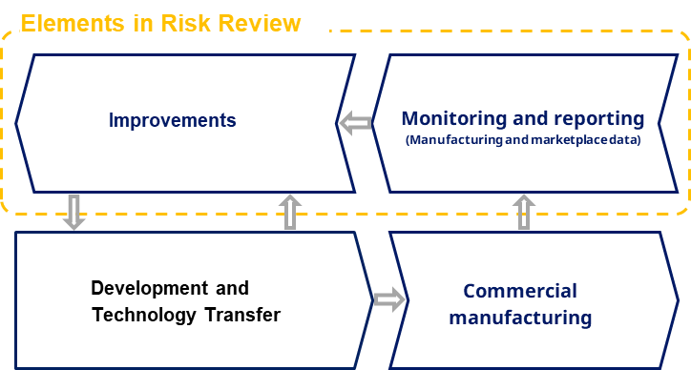
QRM and KM
Key steps of Knowledge flow throughout the lifecycle
In a lifecycle approach using the Pharmaceutical Quality System to guide how knowledge is generated, used and flows, outlines the key activities of Quality by Design
During development and technology transfer products and processes are designed
Knowledge of risk scenarios guide the decisions to focus development studies as well as establishment of risk controls as part of the control strategy
In commercial manufacturing, day-to-day risk-based decisions are made to ensure the state of control is maintained.
Data and knowledge are collected to show actual performance
New knowledge based on monitoring of manufacturing and marketplace data is used to escalate and report issues and trigger need for continual improvements
Improvements may include changes to product design, process design or identified risk control measures as part of the control strategy

Slide 17
PQS and Product Lifecycle
QRM is an iterative process, and not a one-time activity
Utilisation of QRM activities leads to a greater assurance of quality through continual oversight of risks and enhancing effectiveness of risk control
Ensuring that QRM and KM are embedded in the PQS includes:
QRM processes that are well-informed by evolving knowledge
Defined and documented processes as required in the PQS, along with staff training
Involving individuals with appropriate knowledge (both technical expertise and QRM expertise)
Selecting tools that are appropriate to the different aspects of the QRM process
Maintaining appropriate communications and management review of risks throughout the lifecycle
For more information on the links between Knowledge Management and QRM, see ICH Q9(R1) training materials, such as the “Risk-based Decision-making” and “Product Availability” slides.
Go to training library at www.ich.org, and click on ICH Q9(R1)

Slide 18
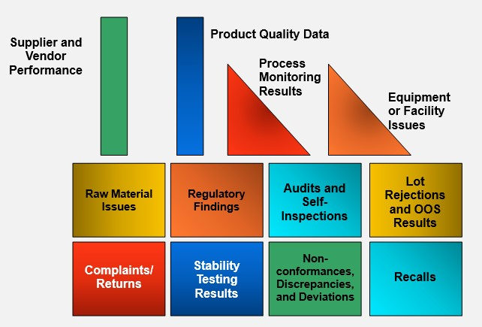
PQS and Product Lifecycle
Iterative Knowledge Supports Effective Risk-based Decision-making
Sources of Lifecycle GMP Knowledge:
Prior knowledge
Pharmaceutical development studies
Technology transfer activities
Process validation studies over the product lifecycle
Continual improvement and change management activities
Manufacturing experience; deviations, customer complaint, returns, CAPA and OOS’s assessments.
See diagram on the bottom right for an illustration of elements of the Process Performance and Product Quality Monitoring system as per ICH Q10
Pharmaceutical Development
Technology
Transfer
Commercial
Manufacturing
Discontinuation

Slide 19
PQS and Product Lifecycle Building knowledge … Monitoring, Oversight, and Adaptation
Process performance and product quality monitoring system that ensures evaluation of each product and process
Management Review of process performance and product quality
Corrective Action and Preventive Action (CAPA) system
Change Management system
Product
Lifecycle
Pre-market Stage of Lifecycle
Post-approval Stage of Lifecycle
Key Message: This chart, which is for illustrative purposes only, shows that the post-approval stage of the product lifecycle provides the vast amount of practical scientific knowledge from actual commercial process and product experience. During this time, extensive process and product knowledge is developed. This illustrates the importance of monitoring, oversight, and appropriate adaption during this phase.
19

Slide 20
The Pharmaceutical Quality System
at Development Stage
International Council for Harmonisation of Technical Requirements
for Pharmaceuticals for Human Use

Slide 21
Key steps in development - for submission
Consider QTPP as a starting point in developing the product and the manufacturing process
Determine CQAs as the characteristics that ensure desired product quality
Use development data and prior knowledge to initially understand variables and their impact
Conduct Design of Experiments (DoE) studies, with awareness that these findings alone do not account for all sources of variability
Quality Target Product profile (QTPP)
Critical Quality Attributes (CQA)
Critical Process Parameters (CPP)
Control Strategy
Conduct risk assessment on the manufacturing process to initially identify the critical characteristics (e.g. critical process parameters (CPP) and critical material attributes (CMA))
Conduct additional experiments/analyses as needed and guided by the risk assessments to fill gaps in knowledge of risk scenarios
Confirm understanding at scale and establish initial control strategies to control risk to product quality and patient safety

Slide 22
Understanding the QTPP (Quality Target Product Profile)…
The introduction of ICH Q9(R1) states that “…the protection of the patient by managing the risk to quality should be considered of prime importance.”
The QTPP provides an understanding of what will ensure the quality, safety, and efficacy of a specific product for the patient and is a starting point for identifying the CQAs.
Defining the quality target product profile (QTPP) as it relates to quality, safety and efficacy, considers, e.g., the route of administration, dosage form, bioavailability, strength, purity, and stability; identifying potential critical quality attributes (CQAs) of the drug product, so that those product characteristics having an impact on product quality can be studied and controlled; determining the critical quality attributes of the drug substance, excipients etc., and selecting the type and amount of excipients to deliver drug product of the desired quality; selecting an appropriate manufacturing process. It also helps to define the control strategy.

Slide 23
Knowledge guides, and is an essential output of, development
Prior knowledge may include
Internal knowledge: from development and manufacturing
External knowledge: scientific and technical publications (including literature and peer-reviewed publications)
After the initial risk assessment based on prior knowledge and relevant experience for the product and manufacturing process:
Further experimentation can be used to fill gaps in knowledge and address uncertainty and complexity
Assignments of risk levels must be appropriately justified
Risk assessments/control will iterate as relevant new information becomes available
Final iteration for the submission shows control of risks to an acceptable level based on knowledge at that lifecycle stage…
More information about formality to address importance, uncertainty and complexity can be found in the ICH Q9R1 training materials.

Slide 24
Residual Uncertainty After Design Stage: Key ICH Q9(R1) Themes
Regarding the quality of the data that informs decision making, ICH Q9(R1) states: “In doing an effective risk assessment, the robustness of the data set is important because it determines the quality of the output.”
“Revealing assumptions and reasonable sources of uncertainty will enhance confidence in this output and/or help identify its limitations.”
“The evaluation of the risk to quality should be based on scientific knowledge and ultimately link back to the protection of the patient”
Design Stage always includes some degree of residual uncertainty. As commercial lifecycle experience is gained, a higher understanding of manufacturing, including parameters, input materials, and other variables, will emerge.
As knowledge increases, uncertainty decreases. Thus, as you gain more relevant knowledge, uncertainty in decision-making will decrease. See the risk-based decision-making training materials that accompany ICH Q9(R1).

Slide 25
Understanding the Control Strategy…
The control strategy derives from management of risk in alignment with the Quality Target Product Profile (QTPP), and it leads to consistent product quality by ensuring reduction of risk
Control strategy is:
Not a new concept
Not just specifications
Based on product and process understanding, knowledge management, and risk management
While design space is optional, control strategy is not.
Control Strategy evolution over the lifecycle: New knowledge from scale-up, technology transfer and manufacturing experience can lead to increased understanding of risk and hence control strategy improvements under the PQS (and filings, when needed, per regulatory requirements)
A Control Strategy is:
“A planned set of controls, derived from current product and process understanding, that assures process performance and product quality. The controls can include parameters and attributes related to drug substance and drug product materials and components, facility and equipment operating conditions, in-process controls, finished product specifications, and the associated methods and frequency of monitoring and control.”
- ICH Q10
Note: See ICH Q8(R2), Q9(R1), Q10 Guidelines for additional relevant terminology

Slide 26
Understanding the design space…
The relationship between the process inputs (material attributes and process parameters) and the critical quality attributes can be described in the design space (optional)
A description should be provided in the application of the process parameters and material attributes considered for the design space
Including rationales for which were included and their effect on product quality
Can be for a unit operation or for the entire process
Design Space:
“The multidimensional combination and interaction of input variables (e.g., material attributes) and process parameters that have been demonstrated to provide assurance of quality. Working within the design space is not considered as a change. Movement out of the design space is considered to be a change and would normally initiate a regulatory post approval change process. Design space is proposed by the applicant and is subject to regulatory assessment and approval”
- ICH Q8(R2)
Note: See ICH Q8(R2), Q9(R1), Q10 Guidelines for additional relevant terminology

Slide 27
EXAMPLE:
Using Risk Assessment to help define the control strategy to meet the Critical Quality Attributes (CQAs) for a product

Slide 28
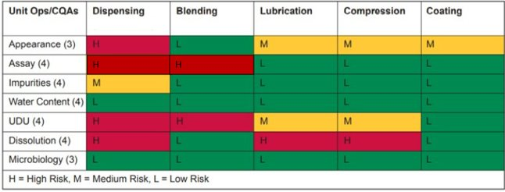
Initial Risk Assessment Activity
Meeting the CQAs for a tablet product can be achieved through understanding the impact that the various unit operations in the manufacturing process have on the CQAs.
Based on initial Risk Assessment, and using existing process and product knowledge, the impact of each unit operation on each CQA was documented:
For each CQA, the company then performed a series of iterative studies (see next slide for details) to increase its level of process understanding as to how the medium and high-risk unit operations acted to impact on the CQA in question. This knowledge of the mechanisms of impact enabled a control strategy to be determined to ensure consistent product quality.
Key message: The understanding of how different unit operations influence CQAs and the underlying mechanisms behind these impacts led to a well-informed control strategy. This knowledge-driven approach allowed for effective risk-based decisions regarding the control strategy.

Slide 29

Understanding variables and their impact – Blending Unit Operation
For the Blending unit operation, the process variables were listed and initially assessed for impact on the CQAs using the initial development data and other prior knowledge.
Design of Experiments (DoE), and other studies were performed to further investigate and understand the impact of the variables, with a higher focus placed on the more impactful variables, and also on those variables where knowledge was lacking.
The risk assessment was updated using the new data, and the new knowledge of the impact was used to initially decide what needed to be controlled to manage the impact, and to initially identify critical characteristics (CPPs and CMAs)
The assessment was further used to prioritise focus in later studies and to ultimately establish a control strategy for the unit operation. This control strategy included limits for blending time and blending speed, and it reflected the type of blender used, as well as the particle size distribution profile of the active substance.
The conclusions reached via the risk assessment work, and the control strategy proposed, were later confirmed during scale up studies, and by process validation.

Slide 30
Process control using PAT
Alternative approach: Blend uniformity monitored using a process analyser
On-line NIR spectrometer used to confirm scale-up of blending
Blending operation complete when mean spectral std. dev. reaches plateau region
Plateau may be detected using statistical test or rules
Feedback control to turn off blender
Company verifies blend does not segregate downstream
Assays tablets to confirm uniformity
Conducts studies to try to segregate API
Plateau region
Number of Revolutions of Blender
Data analysis model will be provided
Plan for updating of model available
Acknowledgement: Adapted from ISPE PQLI Team

Slide 31
Different strategies for controling Assay and Unformity of Dosage Units in blending
Based on the process understanding gained from various iterative studies and available technology, two different control strategies were proposed, as shown below:
Control strategy – Option 1:
Blending time
Blending speed
Equipment (blender type)
Drug substance particle size
Control strategy – Option 2:
Control of blending end point by NIR
Drug substance particle size
Process understanding
Note: With control strategy Option 1, it becomes feasible to integrate drug substance particle size as an input variable within the design space, along with the process parameters of blending time and blending speed. This integration allows for the construction and visualization of a three-dimensional design space.

Slide 32
The potential for RTRT (Control Strategy 2)
Assay and Content Uniformity – traditional approach to testing
The assay acceptance criterion at release was 95.0-105.0% of the labelled amount (30mg of active substance per tablet).
The Uniformity of Dosage Unit acceptance criteria were as per the relevant pharmacopoeia.
Both tests were run using offline HPLC performed in the QC lab.
Note: The compression unit operation is important in relation to the mass uniformity aspect of the Uniformity of Dosage Units CQA.
Studies showed that assay and blend uniformity could be monitored using an online NIR spectrometer in the blending unit operation… this introduced the potential for Real Time Release Testing:
The blending end-point could also be determined using the online NIR spectrometer.
This had the potential to replace the end-product QC tests for Assay and Unit Dose Uniformity (UDU) CQAs with the online NIR testing as part of the RTRT strategy.
If this strategy is employed, it is still important to note that, if tested off-line, the batch would be expected to meet the finished product specifications for assay and content uniformity.

Slide 33
Key messages from this example:
An understanding of the impact that the unit operations in a manufacturing process have on the CQAs of the product is important.
Initial Risk Assessment activities can help facilitate this understanding, and they can help identify where specific additional studies, such as DoE experiments, should be performed, to explore the specific factors and variables that may cause a specific unit operation to impact upon a specific CQA.
This example concerns a tablet manufacturing process. It focusses on the blending unit operation which was identified via initial risk assessment work as having a high impact on two CQAs - Assay and Content Uniformity CQAs.
Through the process understanding that was gained from initial risk assessment work and the knowledge gained from further iterative studies, two different control strategies were proposed - one based on traditional controls and the other employed a PAT NIR spectrophotometer involving a continuous interrogation of blend assay and uniformity using a robust NIR model.
This example shows the interplay between risk assessment (ICH Q9(R1)), process understanding (ICH Q8(R2)) and the use of knowledge (ICH Q10) to inform the chosen control strategy.

Slide 34
The Pharmaceutical Quality System
at Technology Transfer and
Commercial Manufacturing Stages
International Council for Harmonisation of Technical Requirements
for Pharmaceuticals for Human Use

Slide 35
Commercial Manufacturing Stage
Key Concepts
Pharmaceutical Quality System Assures State of Control
Scale-up and Technology Transfer
Process Validation
Senior Management Oversight
Continual Improvement and Change Management – of the Process and PQS
Legacy Products
Examples

Slide 36
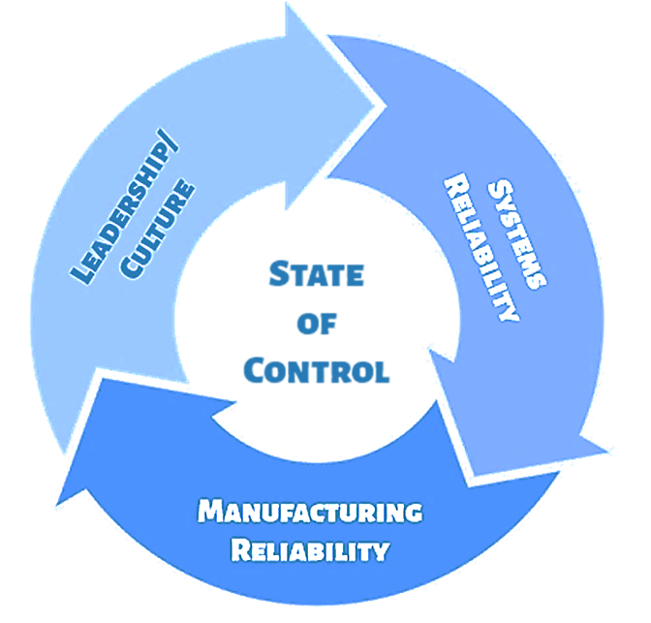
The Objective of a Pharmaceutical Quality System
State of Control
A condition in which the set of controls consistently provides assurance of continued process performance and product quality.

Slide 37
Building early lifecycle knowledge… Scale-up and Tech Transfer
“Monitoring during scale-up activities can provide a preliminary indication of process performance and the successful integration into manufacturing. Knowledge obtained during transfer and scale up activities can be useful in further developing the control strategy.”
ICH Q10 Table 1 - Technology Transfer
indication of process
indication of process
performance and the
performance and the
successful integration
successful integration
into manufacturing.
into manufacturing.
Knowledge obtained
during transfer and
during transfer and
scale up activities
can be useful in
further developing

Slide 38
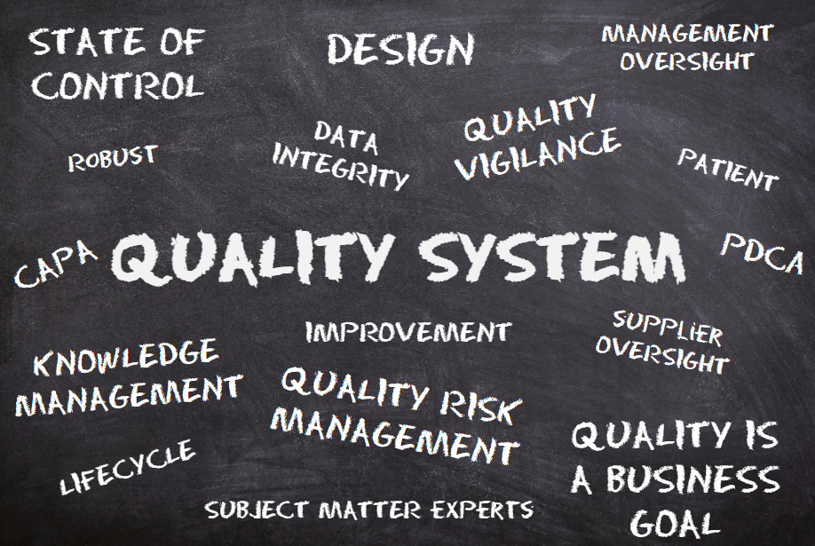
From Development to Tech Transfer to Commercial Processing...Iterative Knowledge is Always Being Gained
“The pharmaceutical quality system should assure that
the desired product quality is routinely met,
suitable process performance is achieved,
the set of controls are appropriate,
improvement opportunities are identified and evaluated,
and the body of knowledge is continually expanded.”
- ICH Q10

Slide 39
How the PQS Assures State of Control Throughout Commercial Lifecycle
Pharmaceutical
Development
Technology
Transfer
Commercial
Manufacturing
Discontinuation
A core principle of ICH Q10 is State of Control. Maintaining a continued State of Control during the commercial lifecycle requires effective use of the 4 elements of the PQS:
Process Performance and Product Quality Monitoring
Corrective Actions and Preventive Actions
Change Management
Management Review
The PQS also includes continual improvement of the:
Products
Processes
PQS itself
This necessitates Senior Management support.

Slide 40
Process Validation
The first commercial batch process validation activities (process qualification) provide an initial evaluation of suitability of commercial operation, and begins to builds confidence in the product and process
Process validation program evaluates state of control throughout lifecycle
Not a one-off exercise (e.g., 3 batches do not guarantee future state of control)
Starts earlier in the product lifecycle and continues throughout the remainder of the product lifecycle
Development knowledge, QRM tools, product quality data, process performance data (e.g., statistical process capability and control analysis to monitor performance)
See ICH Q10 Section IV.B

Slide 41
Senior Management Responsibilities cont’d
Management commitment to continual improvement and to surfacing emerging issues
Active senior management oversight of quality/manufacturing performance and support for continual improvement is essential to assure a continuing state of control
Quality policy & planning
Ensure establishment and communication of quality policies, and provide appropriate resources and training to achieve the quality objectives
Communicate quality policies throughout the company and periodically review them to ensure effectiveness
Monitor performance measurements that determine progress against quality objectives, communicate results regularly, and act upon them, whenever appropriate
Resource management
Assure adequate resources (human, financial, materials, facilities, and equipment) to implement and maintain the pharmaceutical quality system and continually improve its effectiveness
Appropriately apply resources to a specific product, process, or site.

Slide 42
Senior Management Responsibilities cont’d
Internal communications
Processes should ensure the flow of appropriate information between all levels of the company, and the appropriate and timely escalation of certain product quality and pharmaceutical quality system issues.
Management of Outsourced activities and Quality of Purchased Materials:
Use quality risk management principles to develop a program that effectively oversees external materials and outsourced functions (e.g., audits, material evaluations, qualifications, supplier change management approvals);
Assess potential outsourcing suppliers or material suppliers prior to decision whether to select them as a supply chain partner (ensure suitability and competence);
Define the specific supply chain, and ensure that the agreed supply chain is being used;
Define responsibilities and communication processes (e.g., required notifications, regular meetings) within written quality agreements;
Monitor and review ongoing performance of service providers of outsourced activities and suppliers of purchased materials and identify and implement improvements.

Slide 43
Senior Management Responsibilities cont’d
ICH Q10 describes the importance of senior management accountability and responsibility. This lifecycle responsibility includes requires particular vigilance during the commercial phase of the lifecycle, and includes:
Participate in the design, implementation, monitoring, and maintenance of an effective pharmaceutical quality system.
Demonstrate strong and visible support for the pharmaceutical quality system and ensure its implementation throughout their organization.
Ensure a timely and effective communication and escalation process exists to raise quality issues to the appropriate levels of management.
Define individual and collective roles, responsibilities, authorities, and inter- relationships of all organizational units related to the pharmaceutical quality system. Ensure these interactions are communicated and understood at all levels of the organization. An independent quality unit/structure with authority to fulfill certain pharmaceutical quality system responsibilities is required by regional regulations.
Conduct management reviews of process performance and product quality and of the pharmaceutical quality system.
Advocate continual improvement.
Commit appropriate resources.

Slide 44
Continual Improvement and Change Management
An Effective PQS will:
Utilise Knowledge, Process Understanding, and QRM to identify potential changes that will lead to improvements
Evaluate those potential changes using QRM principles
Use QRM to determine whether the change is appropriate
Also determine whether the manufacturer must notify health authorities, and if so, whether this requires a prior notification.
If using the ICH Q12 approach, the regulator may allow a lower submission category for certain marketing authorisation changes

Slide 45
Change Management
Appropriate evaluation of change includes a confirmation of successful change implementation (e.g.)
Extra monitoring, testing, or additional interim controls
Process Validation
New studies may be needed to validate a change
Lifecycle monitoring also provides an opportunity to assess change effectiveness and maintaining a state of control
Effectiveness verification may also be reported in annual Product Quality Review (PQR)
Notes whether the effectiveness of a change has been demonstrated
QRM drives effective lifecycle change evaluation

Slide 46
Change Management in the PQS:
Risk-Based Lifecycle Approach
ICH Q10 Table III:
Application of Change Management System Throughout the Product Lifecycle
Pharmaceutical Development | Technology Transfer | Commercial Manufacturing | Product Discontinuation
Change is an inherent part of the development process and should be documented; the formality of the change management process should be consistent with the stage of pharmaceutical development. | The change management system should provide management and documentation of adjustments made to the process during technology transfer activities. | A formal change management system should be in place for commercial manufacturing. Oversight by the quality unit should provide assurance of appropriate science- and risk-based assessments. | Any changes after product discontinuation should go through an appropriate change management system.
Change management applies across the entire product lifecycle.
When evaluating a proposed change, the evaluation is based on quality risk management principles in ICH Q9(R1).
Staff with appropriate expertise and knowledge should evaluate proposed significant changes.

Slide 47
Continual Improvement of the PQS
Inputs (examples)
PQS Processes (e.g., Complaints, deviations, change management)
Outsourced activities
Self-assessment processes (audits, risk assessments, trending)
External assessments (e.g. inspections, audits)
Resource management
Gauge State of Control of Facility/Equipment/Processes
Standards & regulations
Changes in business environment
Product ownership
PQS Improvements
Allocation of resources (infrastructure, staffing, quality improvement programs, etc.)
Revisions to quality policy and objectives
Personnel competencies
Documentation
Communication
Systems (quality management processes; policies; programs; oversight) modifications
Continual
Improvement
Expanded
Body of Knowledge
PQS Management

Slide 48
Continual Improvement of the Product
Inputs (examples)
Ongoing Commercial Manufacturing Experience (starting with scale-up)
Deviations / CAPA
Performance Monitoring
Customer Complaints
Management Reviews
Material Variation
Lifecycle Adjustments
Often readily achieved incrementally in response to routine feedback;
May require substantial product/process/facility design changes to address gaps or flaws in original concept;
Quality system ensures appropriate and timely implementation, maintenance and improvements of design and control approach
Continual
Improvement
Expanded
Body of Knowledge
Lifecycle Management

Slide 49
Data-driven Quality Vigilance and Continual Improvement
Process Tracking and Trending
Statistical Process Control
On-going analysis and trending of process data (SPC, etc.)
Analyze parameters, materials & other attributes
Deviations
Critical Objective:
Identify emerging trends before they become quality problems
Product Quality Monitoring
Review quality data (batch quality results, complaints, returns, stability issues, etc.)
Reduce sources of variation
Assess individual events, and also evaluate trends (e.g., aided by use of statistical tools)
In combination, the above process and quality monitoring provides for ongoing vigilant oversight of quality
Control Limits: Derived from Historical Release Data
Trend Limits: Derived from Historical Stability Data
Specs
Trend Limits

Slide 50
Continual Improvement of New and Legacy (already commercialized) Products
An effective quality system deals with knowledge gained to stimulate continual improvements of both new and legacy products
Industry is encouraged to use the trio of guidelines to improve legacy systems, processes, and products. Old technology and quality management systems approach often prove ineffective and inefficient.
There are significant advantages to continually improve products using principles of ICH Q8(R2), Q9(R1), Q10
Better product/process understanding, product quality, and reduced waste (e.g. rejects)
Reduce process variability
Add innovations that improve quality assurance and efficiency
Industry can work with regulators to improve their management of quality risks for these products, in accordance with ICH Q9(R1)

Slide 51
EXAMPLE:
A Proposed Near Infra Red (NIR) PAT/Chemometric Model for monitoring Content Uniformity in a Tableting Process as part of a Real Time Release Testing application - some key inspection considerations

Slide 52
Inspection of the NIR model
A NIR PAT application supported by chemometrics data processing was proposed in a marketing authorization application for monitoring content uniformity in a tableting process and for Real Time Release Testing
Following an initial assessment by Assessors, the model was reviewed during a Pre-Approval Inspection (PAI).
The experience gained with the model during tech transfer and scale-up activities was reviewed during the inspection, as was the approach taken to verification and validation of the model and its maintenance within the site’s pharmaceutical quality system.
Validation/
Verification of
Predictions
Learning
Inspection Focus
Predictions from
Development Studies (process models)
Experimentation and Data Analysis
Assessment Focus
The inspection reviewed the level of confidence in the NIR model as compared to that with the traditional Quality Control laboratory method

Slide 53
Inspection of the model, cont’d
Key areas inspected were:
Calibration and qualification of the NIR equipment, including its probes and sensors
Calibration and maintenance of the NIR model
Validation of the data handling software associated with the NIR model, including its statistical analysis functionalities
NIR sample sizes and frequency of sampling
Did the model provide for continuous monitoring?
Were samples representative of the process? (e.g. tablet weight from each compression head)
Side-by-side verification testing of the NIR model vs. the off-line reference method for a substantial number of commercial batches was also a key area of focus
The use of the data from the model to support the RTRT approach
The handling and management of deviations

Slide 54
Inspection of the model, cont’d
The application of QRM principles to ensure the fitness for use of the NIR model was also a key area of focus during the inspection
Key QRM related inspection questions were:
How had QRM been applied during the design, control, verification/validation and technology transfer of the model and its associated NIR equipment?
What hazards and associated risk scenarios had been identified in relation to the introduction of the model and its associated equipment at the site? And how had those risk been managed?
How had QRM been incorporated into the site’s change control process for managing changes to the model and its associated software and equipment over its lifecycle?
Was there an appropriate level of lifecycle oversight in place, and how would this fit into the concept of risk review?
What level of risk reduction did introduction of the model deliver, and how was that assessed or measured?

Slide 55
How this example relates to the three guidelines
The introduction of PAT and chemometrics models such as in this example requires the application of the guidance in ICH Q8(R2), ICH Q9(R1) and ICH Q10
ICH Q8(R2) refers to knowledge gained through the application of scientific approaches and quality risk management in achieving a comprehensive understanding of the product and its manufacturing process.
It indicates that such knowledge and understanding supports the establishment of manufacturing controls, and that throughout the product lifecycle, companies have opportunities to evaluate innovative approaches to improve product quality.
ICH Q9(R1) states that the application of digitalization and emerging technologies in the manufacture and control of drug (medicinal) products can lead to risk reduction, when such technologies are fit for their intended use.
Such technologies can introduce risks that may need to be controlled, and that the application of quality risk management to the design, validation and technology transfer of advanced production processes and analytical methods, advanced data analysis methods and computerized systems is important.
The guidance in ICH Q10 is also important in the context of this example, given its emphasis on continual improvement and also the role of Knowledge Management and Quality Risk Management as enablers to an effective Pharmaceutical Quality System.

Slide 56
Final points for this presentation
The three guidelines ICH Q8(R2), ICH Q9(R1) and ICH Q10 work together as building blocks in the Pharmaceutical Quality System a lifecycle framework:
ICH Q8(R2) - Pharmaceutical Development
ICH Q9(R1) - Quality Risk Management
ICH Q10 - Pharmaceutical Quality System
The trio facilitates appropriate risk-based decision making, starting at the drug development stage and continuing throughout the entire product lifecycle.
The three guidelines help ensure:
Science and risk-based product and process development;
Successful technology transfer;
Continual improvement throughout the commercial lifecycle to ensure a continued state of control.
Other ICH Quality guidelines published before and after supplement the above three guidelines, and they are important not to overlook.

Slide 57
Acknowledgment and Contact
Acknowledgement to ICH Q9(R1) Implementation Working Group (IWG)
For any questions please contact the ICH Secretariat:
admin@ich.org

